Slide 1
Hanyoyin Sadarwar Zamani da Tasirunsu Ga Al’ummar Najeriya
Taron Bita Na Musamman ga Limaman Birnin Tarayya, Abuja
Fou’ad Lababidi Islamic Academy, 14th – 15th May, 2016
Shiryawar:
FCT IMAMS FORUM
Wallafar:
ABDULLAHI SALIHU ABUBAKAR (Baban Sadik)
www.facebook.com/babansadik
fasaha2013@gmail.com
08034592444

Slide 2
MAƘUNSHI
Marigayi Malam Aƙilu Aliyu
Manufa da Mahimmancin Sadarwa - Gabatarwa
  Mahimmancin Maudu’i
  Sadarwa: Me Ake Nufi?
  Manufofin Sadarwa
Hanyoyi da Na’urorin Sadarwa
Fasahar Sadarwar Zamani a Najeriya
Shafukan Sada Zumunta
Kyawawan Tasirin Hanyoyin Sadarwa
Munanan Tasirin Hanyoyin Sadarwa
Hanyoyin Kariya
Naɗewa
???

Slide 3
MARIGAYI MALAM AKILU ALIYU
Kiranmu nake jama’a mu ji
Mu amsa kar fa mu dakile;
Mu lura da saurin zamani
Ya dafe kansa ya walwale;
A gurguje ba ya waiwaye
Mu nace binsa azalzale;
- Marigayi Malam Akilu Aliyu, cikin wakarsa ta “Kalubale”

Slide 4

MANUFA DA MAHIMMANCIN SADARWA

Slide 5
GABATARWA
Mahimmancin Maudu’i
  Ta’allakuwar imani da addini dashi
  Ilimi kafin aiki
  Yin rayuwa mai inganci
  Zamani zo mu tafi
Sadarwa: Me Ake Nufi?
  Tsarin isar da manufa/sako tsakanin mutane biyu, ta amfani da zance ko rubutu ko ishara ko alama.
  Tsarin aikawa da karban sakonni ta amfani da hanyoyi da na’urorin sadarwa na zamani

Slide 6
GABATARWA (ci gaba)
Manufofin Sadarwa
  Isar da manufa (umarni ko hani ko bukata)
  Ilmantarwa
  Tabbatar da Tsari Cikin Al’umma
  Fahimtar Juna ta musayar fahimta

Slide 7
HANYOYI DA NA’URORIN SADARWA
Fasahar Sadarwa ta Zamani (Information Communication Technologies - ICTs)
  Tsarin aiwatar da sadarwa mai inganci ta amfani da hanyoyi da na’urorin sadarwa na zamani
    Dillalai: Ka’idojin sadarwa (Communication Protocols) = > IP da TCP dsr
    Hakan ya haifar da Gamammiyar Zumunci (Network Convergence) tsakanin na’urorin sadarwa = > wayar salula da kwamfuta, Intanet da Imail dsr

Slide 8
HANYOYI DA NA’URORIN SADARWA (ci gaba)
Kayayyakin Sadarwar Zamani (Communication Devices)
  Kwamfuta
  Wayar Salula
  Na’urorin Sadarwa (iPad, da Samsung Galaxy Note, MS Surface, Google Nexus dsr)
  Tauraron Dan Adam (Communication Satellite)
    GLONASS (Kasar Rasha)
    GPS (Kasar Amurka)
    Galileo (Nahiyar Turai)
    SAT-3 (Intanet)

Slide 9
HANYOYI DA NA’URORIN SADARWA (ci gaba)
Hanyoyin Sadarwa na Zamani (Communication Channels)
  Fasahar Intanet da Manhajojinta
  Fasahar Imel
  Short Message Service (SMS)
  Multimedia Service (MMS)
  Fasahar Bluetooth
  Fasahar Flash Share
  Fasahar Wi-Fi Direct
  Fasahar Infra-Red
  Fasahar Talabijin Zamani (Satellite Television)
  Fasahar Rediyo na Zamani (Satellite Radio)

Slide 10
HANYOYI DA NA’URORIN SADARWA (ci gaba)
Fasahar Intanet
  Giza-gizan sadarwa na duniya.
  Hade-haden dake tsakanin kwamfutoci mai basu damar yin ‘zance’ da juna wajen mikawa da karbar sakonni/bayanai.
  Me ake karba?
    Sakonni rubutattu (Text)
    Sakonnin bidiyo (Video Files)
    Sakonnin sauti (Audio Files)
    Hotuna (Images/Pictures)
    Bayanan bayanai (Metadata)
  A layin Intanet ake samun “Web” ko “World Wide Web”: Yanar sadarwa ta duniya.
  Sinadarai: ka’idojin sadarwa ta Internet Protocol (IP) da Internet Control Protocol.
  Mallakin waye?
  Adadin kwafutoci dake kan Intanet: biliyan 2 da doriya
  Adadin masu amfani da Intanet a duniya: biliyan 3.3
  Wa ke lura da fasahar?
    Internet Corporation for Assigned Names and Numbers (ICANN)
    Internet Engineering Task Force (IETF)
    World Wide Web Consortium (W3C)
  Fasahar Intanet ce sababin habakan harkar sadarwa a duniya

Slide 11

HANYOYI DA NA’URORIN SADARWA (ci gaba)

Slide 12
HANYOYI DA NA’URORIN SADARWA (ci gaba)
Adadin masu amfani da fasahar Intanet a duniya. Kididdigar Nuwamba, 2015
Lamba | Nahiyoyin Duniya | Adadin Jama'a | Yawan Masu Mu'amala
1 | Asiya | 4,032,466,882 | 1,622,084,293
2 | Turai | 821,555,904 | 604,147,280
3 | Latin Amurka/Karibiyan | 617,049,712 | 344,824,199
4 | Afirka | 1,158,355,663 | 330,965,359
5 | Arewacin Amurka | 357,178,284 | 313,867,363
6 | Gabas-ta-Tsakiya | 236,137,235 | 123,172,132
7 | Ostraliya | 37,158,563 | 27,200,530
 | Jimilla | 7,259,902,243 | 3,366,261,156
http://www.internetworldstats.com/stats.htm

Slide 13
HANYOYI DA NA’URORIN SADARWA (ci gaba)
Wayar Salula (Mobile Phones)
  Wayar tafi-da-gidanka ko wayar hannu, mai amfani da siginal rediyo (radio signal) don karbar kira ko amsa kira tsakaninta da wata waya ‘yar uwarta, a iya kadadar sadarwa (Base Station).
  Don tabbatar da kira ko karba:
    Wayar salula
    Katin SIM (Subscriber Identification Module Card – SIM Card)
    Yanayin sadarwa mai dauke da siginar rediyo (Wireless/Radio Signal)
    Tashar Sadarwa (Base Station)
  Fasaha da Manhaja
    Sakonnin tes (SMS)
    Sakonnin hotuna (MMS)
    Sakonnin murya (VM)
    Fasahar Intanet (Mobile Internet)
    Social Media: Facebook, Whatsapp dsr
  Manyan Madaukai:
    Android
    iOS
    Windows Phone

Slide 14

HANYOYI DA NA’URORIN SADARWA (ci gaba)

Slide 15

FASAHAR SADARWA A NAJERIYA

Slide 16
FASAHAR SADARWAR ZAMANI A NAJERIYA: DAGA INA MUKA FITO?
Kafin Shekarar 2000
  Wayoyin tangaraho ne
  Basu shige layuka 500 ba, tun 1970s
  Tsarin Sadarwar Analog
  Babu kwamfutoci, sai na’urar rubutu (Typewriter)
  Layukan tarho sai wane da wane
  Ba yanayin sadarwa mai inganci

Slide 17
FASAHAR SADARWAR ZAMANI A NAJERIYA: DAGA INA MUKA FITO? (ci gaba)
Bayyanar Tsarin Sadarwar Zamani
  Fasahar Imel, 1990, Jami’ar McMaster (Kanada) da Jami’ar Ilorin;
  1994: Jonu da Ka’idar POP3; Yabatech kadai
  1998: Yaduwar Kamfanonin Sadarwa na Intanet (ISP)
  1999: NITEL ta bayar da lasisin bude Mashakatar Lilo (Cyber Cafe);
    Shaguna 40, tsakanin Legas da Kaduna
    Fasahar Intanet ta Iso Birnin Kano
    Yawaitan shagunan lilo tsakanin Legas, Abuja, Kano, Kaduna, Fatakwal, Jas dsr

Slide 18
FASAHAR SADARWAR ZAMANI A NAJERIYA: DAGA INA MUKA FITO? (ci gaba)
  2000: Fasahar GMS ta diro Najeriya
    Yaduwar wayoyin salula
    Yaduwar layukan tarho => 500,000 zuwa 151m
      Laukan GSM =>
      Layukan CMA =>
      Layukan Fixed Wireless =>
    Yawaitar masu mu’amala da Intanet a Najeriya
      Adadi = >
    Sanayya kan fasahar sadarwar zamani ya karu

Slide 19
FASAHAR SADARWAR ZAMANI A NAJERIYA: DAGA INA MUKA FITO? (ci gaba)
Adadin Layukan Tarho a Najeriya (Maris, 2016)
Lamba | Tsarin Sadarwa | Adadi
1 | Tsarin GSM | 211,732,836
2 | Tsarin CDMA | 3,678,796
3 | Tsarin Fixed Wireless | 353,830
Jimilla |  | 215,765,462
Adadin Layukan Tarho Masu Rai (Active Lines)
Lamba | Tsarin Sadarwa | Adadi
1 | Tsarin GSM | 147,398,854
2 | Tsarin CDMA | 1,170,031
3 | Tsarin Fixed Wireless | 176,579
Jimilla |  | 148,745,464

Slide 20
FASAHAR SADARWAR ZAMANI A NAJERIYA: DAGA INA MUKA FITO? (ci gaba)

Slide 21
FASAHAR SADARWAR ZAMANI A NAJERIYA: DAGA INA MUKA FITO? (ci gaba)
Lamba | Kamfani | Adadi
1 | MTN Nigeria Communications | 61, 262,140
2 | Globacom Limited | 33,011,094
3 | Airtel Nigeria | 32,268,301
4 | EMTS Limited (Etisalat) | 22,161,290
5 | Visafone Limited | 2,197,657
6 | Multilinks Telkom | 10,815
7 | 2st Century Technologies | 103,124
8 | IPNX | 2,823
Jimilla |  | 151,017,244
http://www.ncc.gov.ng/index.php?option=com_content&view=article&id=70&Itemid=226

Slide 22
FASAHAR SADARWAR ZAMANI A NAJERIYA: DAGA INA MUKA FITO? (ci gaba)

Slide 23
FASAHAR SADARWAR ZAMANI A NAJERIYA: DAGA INA MUKA FITO? (ci gaba)
Dalilan yaduwar fasahar sadarwar zamani a Najeriya
  Saukin mu’amala
  Saukin farashi
  Yaduwar nau’uka daban-daban
  Tsarin zumunci a tsakanin na’urorin sadarwa (Network Convergence)
  Karuwar ingancin hanyoyin sadarwa
  Kebantattun siffofin fasahar Intanet
  Ingancin ka’idojin kimiyyar sadarwa
  Dokoki da tsare-tsaren Hukuma

Slide 24

SHAFUKAN SADA ZUMUNTA
Ma’ana:
  Shafuka ko Manhajojin sadarwa dake baiwa jama’a damar musayar ra’ayoyi ta hanyar rubutattun sakonni da hotuna da bidiyo da sauti
  Saurin yaduwa kamar wutar daji
  Masu mu’amala:
    Matasa ‘yan 18 – 25
    Matasa ‘yan 25 – 40
    Mata sun fi yawa (Facebook, Instagram)
    Daliban Jami’a

Slide 25
DANDALIN SADA ZUMUNTA (ci gaba)
Lamba | Kamfani | Madauki | Masu Rajista (Mil)
1 | Facebook | Waya/Kwamfuta | 1,650,000,000
2 | WeChat | Waya/Kwamfuta | 1,120,000,000
3 | Youtube | Waya/Kwamfuta | 1,001,000,000
4 | Whatsapp | Wayar Salula | 1,000,000,000
5 | Weibo | Waya/Kwamfuta | 600,000,000
6 | Tumbler | Waya/Kwamfuta | 420,000,000
7 | Instagram | Waya/Kwamfuta | 400,000,000
8 | Twitter | Waya/Kwamfuta | 320,000,000
9 | Google + | Waya/Kwamfuta | 300,000,000
10 | LinkedIn | Waya/Kwamfuta | 300,000,000
Shafukan Sada Zumunta da Adadin masu rajista. Kididdigar watan Nuwamba, 2015

Slide 26
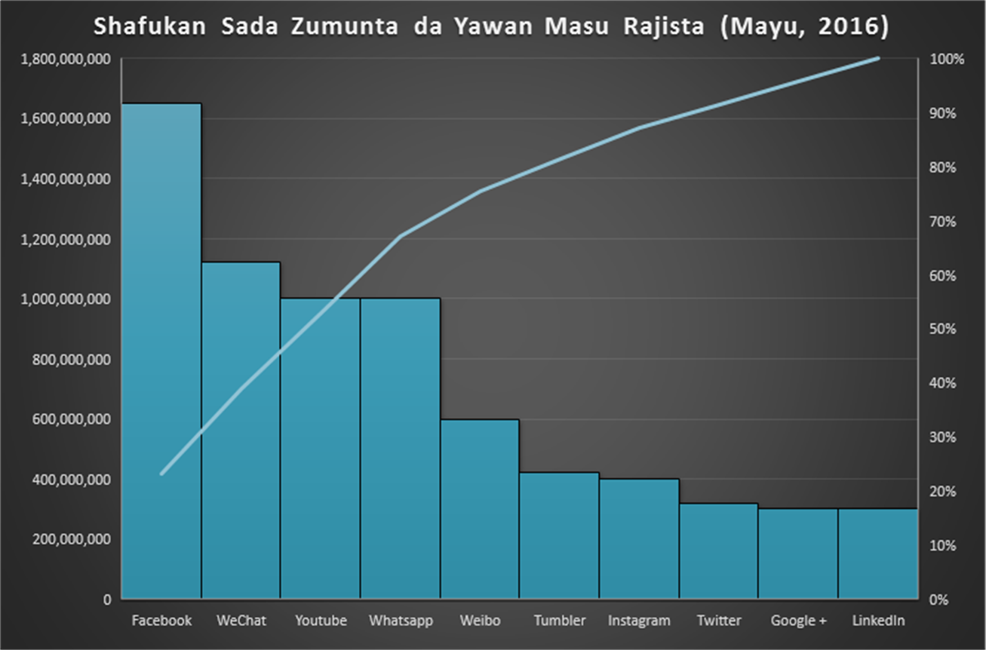
DANDALIN SADA ZUMUNTA (ci gaba)

Slide 27
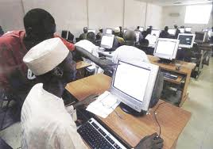
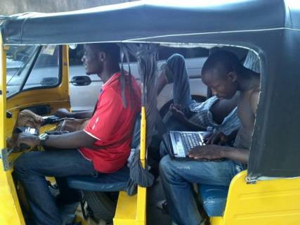
KYAWAWAN TASIRIN HANYOYIN SADARWA NA ZAMANI
Karuwar ilimi da wayewa kan harkokin duniya
Gamammen tsarin sadarwa
Fahimtar addini a sawwake
Karantar da addini a sawwake
Aikin yi ga jama’a
Wayewa a tsarin rayuwa
Saukin rayuwa wajen mu’amala da:
  Hukuma
  Makarantu
  Kamfanoni
  Bankuna
Karatu da karantarwa a fannonin rayuwa
Saye da sayarwa
Karuwar kudaden shiga

Slide 28
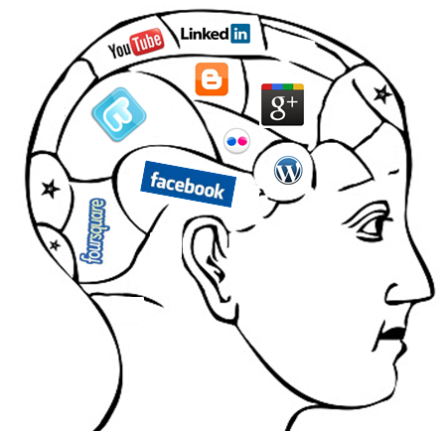

MUNANAN TASIRIN HANYOYIN SADARWA GA AL’UMMA
Tasiri ga addini
  Miyagun akidu da al’adu
    Shi’anci
    Kawarijawa
    ‘Yan boko-akida
Tasiri ga dabi’a
  Miyagun abokanai
  Miyagun shafukan sadarwa
Tasiri ga iyali
  Rashin lokaci
  Kowa tasa ta fisshe shi
Tasiri ga tsarin tunani da mahangar rayuwa
Tasiri ga lafiya (ruhi da gangar-jiki)
Tasiri ga tsaro
Shagala da shagaltarwa

Slide 29

MUNANAN TASIRIN HANYOYIN SADARWA GA AL’UMMA (ci gaba)
Wasu Misalai Abin Dubawa
  ‘Yarka da wayar salula
    Hotuna masu araha
    Bidiyo masu kama zuciya
    Ba sai yazo kofar gidanka ba
  Maigida, ina matarka?
    Fushi da masoyiya, gida ya lalace
    Malamai, ga wata fatawa – sumbar mace da mace a fagen sha’awa ba dabi’ar madigo bace!!!
    Da tsohuwar zuma ake magani – tsohon saurayin amaryar wani
    Yanzu muka gama, ga yadda lamarin ya faru?
    Ban taba sha’awarsa ba, tunda muke tare shekaru 4!
  “Mu hadu a whatsapp, ya fi sirri”
  Daga wa’azi zuwa holewa; haramun ne?

Slide 30
MUNANAN TASIRIN HANYOYIN SADARWA GA AL’UMMA (ci gaba)
  Ko a masallaci fa, abin na yiwuwa
    Dabi’a ta sace ni, ko ni na sace ta?
  Kowa “Malam” ne, laifi ne?
  Ilimi ko wankiya? Daga ina ka debo?
  Kowa ya samu rana:
    “Mu ne masoyan Manzo na hakika”
  Duk abin bautarmu daya ne, hanyar ce ta sha bamban
  Hoto da bidiyo kyauta

Slide 31
HANYOYIN KARIYA
Karfafa tarbiyyarka da na iyalinka
  Ba ko ina ake shiga ba
  Ba kowa ake abota da shi ba
  Wayar salula mai Intanet ga ‘ya mace, ina mafita?
Fadakar da al’umma a mimbarori
  Lura da tsarin mu’amala a dandalin abota
  Ba dukkan fatawa take daidai ba
Koyon tsarin mu’amala da kayayyakin sadarwa na zamani
  Ba su da wahalar sha’ani
  Kowa da koyo ya iya
Alaka da na kwarai wajen sadarwa
  Manyan malaman duniya kusa suke
  Zaurukan jama’ar kwarai suna nan birjik
Kiyaye lokaci
  Iyalinka na da hakki a kanka
  Kwadago amana ce
Manufa ingantacciiya

Slide 32
NADEWA
Hanyoyin sadarwa na dada yawaita sanadiyyar kirkire-kirkire a fannin kimiyya da fasahar sadarwa
Iya sanayyarka ga halin da ake ciki iya wayewarka
Guguwa ce mai dauke da iska mai karfi, wacce ke tumbuke duk wanda ya fuskanceta babu manufa kyakkyawa, kuma tabbatacce a tare dashi
Kashi 60 cikin 100 na masu mu’amala a wannan saaha ba su da manufa tabbatacciya, mai kwari. Don haka, kada ka dogara gare su.
Mahalli ne mai cakude da fari da baki, da mai zaki da mai daci, da mai lami da mai gardi; dole ne ka zabi dandanon da ya dace da kai, kada ka bi zabin wasu, domin dandanonku ya sha bamban
RIGA-KAFI, YA FI MAGANI

Slide 33


